Slide 1
WELCOME
Advanced Web Application Development
CodersTrust
Shams Shahriar
Back-End Developer & Mentor

Slide 2
-Course Objectives -Class, Assignments & Tests

Slide 3
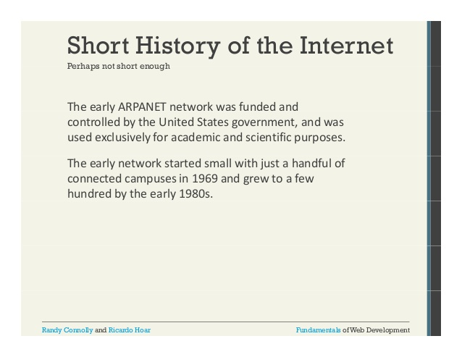
How Web Works?
internet ?

Slide 4
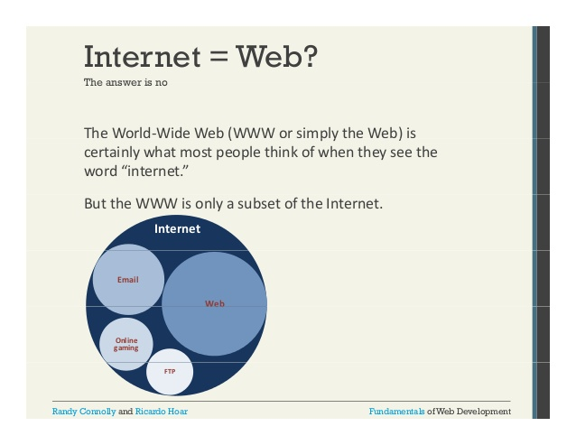
How Web Works?

Slide 5
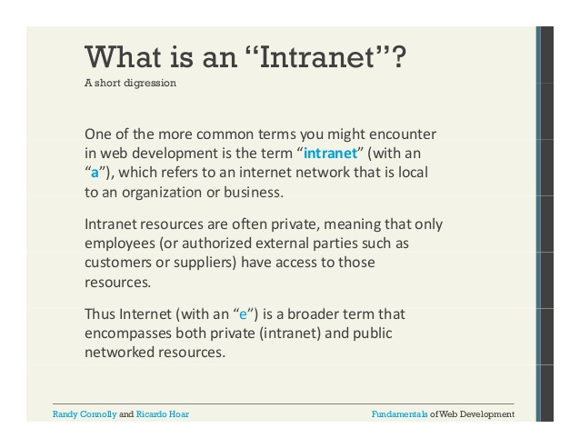
How Web Works?
Have you heard INTRANET?

Slide 6
How Web Works?
How web request done
Request
DNS server
( Get IP )
Response
Web Server
Get Request

Slide 7
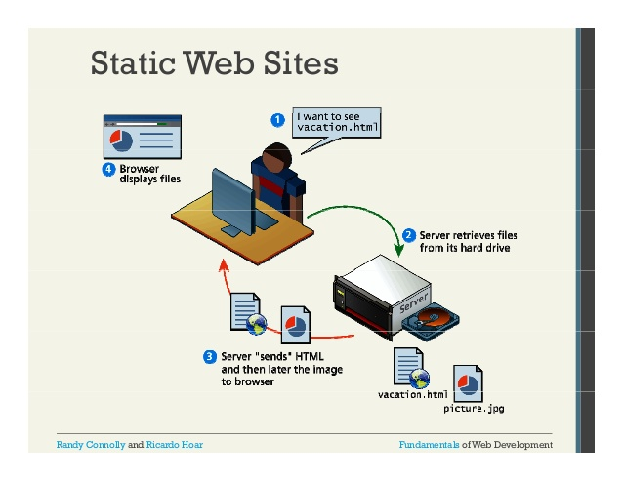
Types of websites
Static Websites

Slide 8
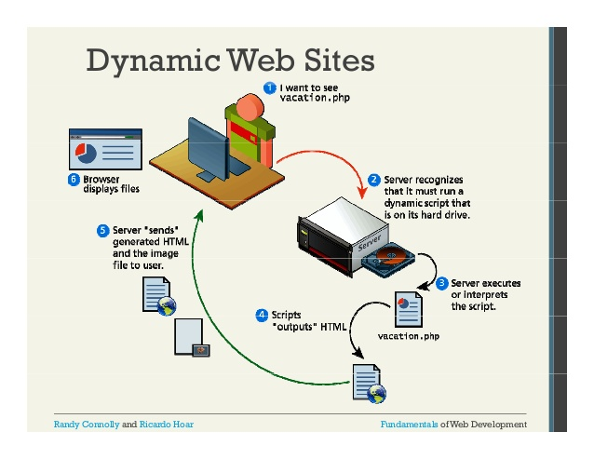
Types of websites
Dynamic Websites

Slide 9
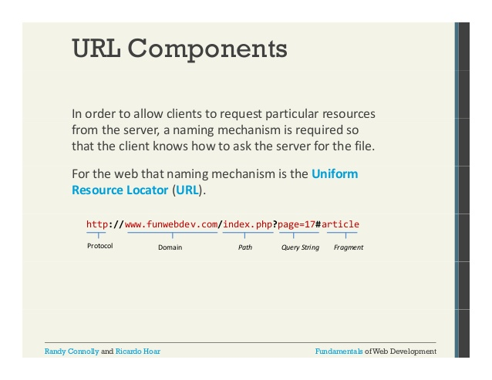
The URL

Slide 10
Website Components
Client Side:
HTML, CSS, JavaScript.
Frameworks: Bootstrap, Vue Js, React js
Server Side:
Python, PHP, Java, C#.
Frameworks: Django, Flusk , Laravel, Spring, ASP.NET

Slide 11
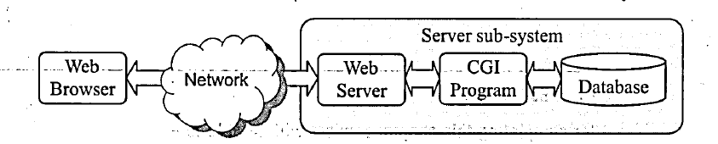
The Days of Future Past
The CGI (Common Gateway Interface)

Slide 12
A CGI Script
#include <stdio.h>
int main() {
printf("Content-type: text/html\n\n");
printf("<html>\n");
printf("<body>\n"); printf("<h1>Hello there!</h1>\n");
printf("</body>\n");
printf("</html>\n");
return 0;
}

Slide 13
History of PHP
PHP ? =
PHP: Hypertext Preprocessor
Two types of coding languages:
Non-Compiled:
The passed directly through the client. Like HTML, CSS
Compiled:
Only their compiled output will be passed. Not the code.

Slide 14
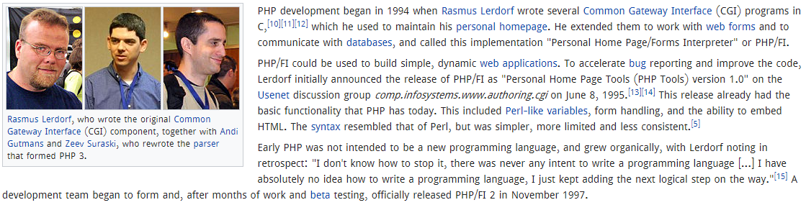
History of PHP

Slide 15
Advanced Development
Well Structured Coding
Maintain world wide acceptable coding format.
Complex and customize development.
The programming knowledge.

Slide 16
Why Framework ?
Acceptance of Code Format.
Re-usable and readable coding
Easy testing and maintain
Parallel development
Upgrade anytime

Slide 17
Why Laravel?
The real MVC framework.
Command line control
Security
Libraries
Fast
Huge community
Object Oriented pattern

Slide 18
The App ? Or Web App ?
Easily Access
Easily Edit
Easy Distribution
Real Time

Slide 19
Why we learn PHP
Easy to learn. Loosely typed language.
Used by many popular websites.
Still Number 3 market position.
Faster Process using HHVM (Facebook)
Now PHP 7 get all over it.
Available jobs in market as well as in software industries.

Slide 20
Some Links For PHP
php.net
Phpfig
Hacker Rank
Laravel.com
Laracast

Slide 21
PHP, Laravel Job Market
- Fiverr
Upwork
Bdjobs
Linked In

Slide 22
Things Need To Start
Xampp Server
Any Editor ( Preferred PHP Storm )

Slide 23
All the best
For the journey

